Slide 1
?
Historical Music
Queensland
OF
This website makes use of the State Library of Queensland’s music database to let you explore the music and events of early 20th century Queensland. View the interactive timeline below to begin your journey.
VIEW TIMELINE

Slide 2
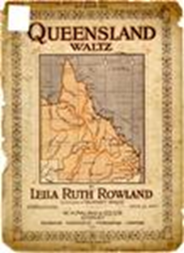
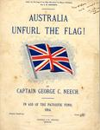
1908
?
Queensland Waltz
Rowland, Leila Ruth
Waltzes
Australia unfurl the flag!
Neech, G. Christian
Songs, English--Queensland
Events
10 March – Australians Douglas Mawson and Edgeworth David accompanied by Ernest Shackleton and others are the first people to scale Mount Erebus in Antarctica.
30 March – Commonwealth Quarantine service came into operation and took over quarantine stations in every state.
20 April – 44 are killed and 400 injured in the Sunshine train disaster.
7 May – The Coat of Arms of Australia are granted Royal Assent.
DEATHS
READ MORE ON WIKIPEDIA

Slide 3
1908
Help
Queensland Waltz
Rowland, Leila Ruth
Waltzes
To access the website, select ‘View Timeline’ from the start page.
You can always return to a previous page or screen by selecting the back arrow in the top left corner or the cross in the top right.
To change years on the timeline, move the circle below the year.
You can view more details and larger images for songs by selectin them from the timeline list.
To view an image larger, select it, you can then view the full image gallery.
Australia unfurl the flag!
Neech, G. Christian
Songs, English--Queensland
Events
10 March – Australians Douglas Mawson and Edgeworth David accompanied by Ernest Shackleton and others are the first people to scale Mount Erebus in Antarctica.
30 March – Commonwealth Quarantine service came into operation and took over quarantine stations in every state.
20 April – 44 are killed and 400 injured in the Sunshine train disaster.
7 May – The Coat of Arms of Australia are granted Royal Assent.
DEATHS
READ MORE ON WIKIPEDIA

Slide 4
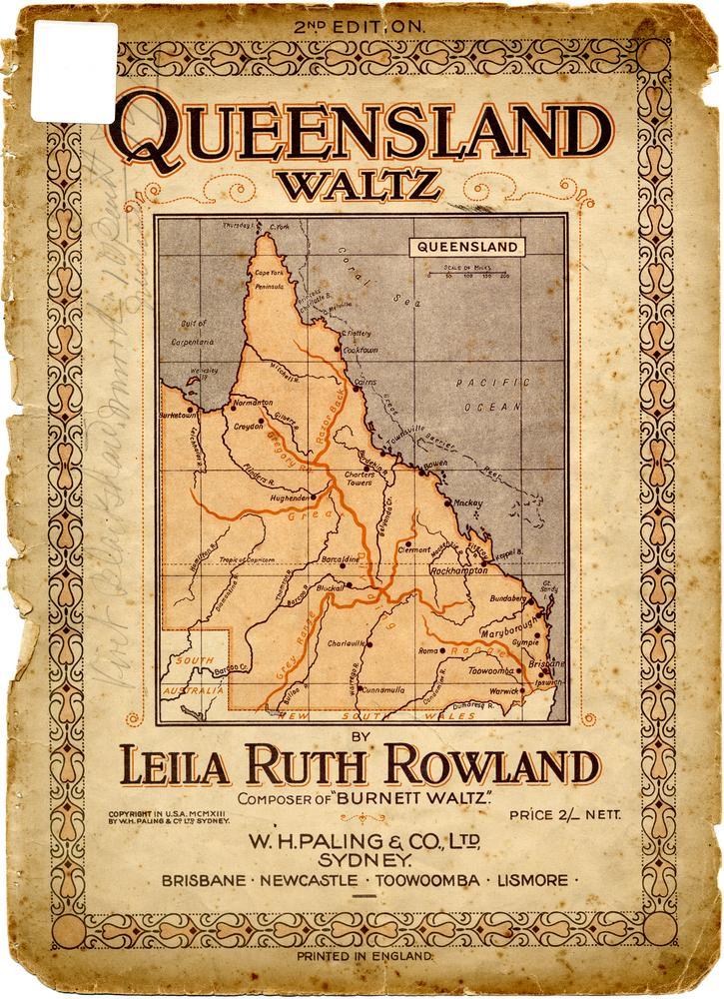
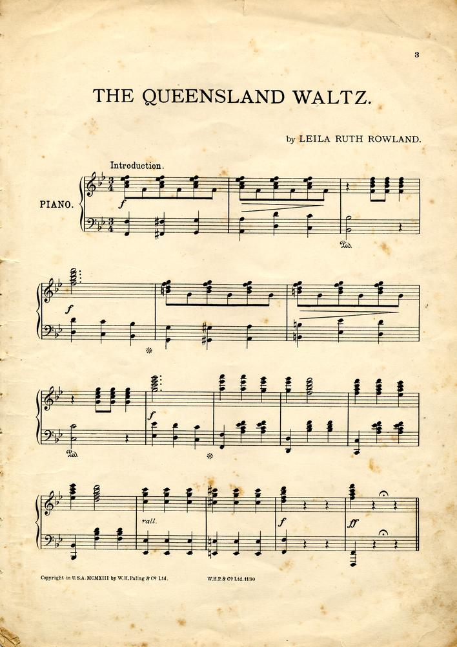
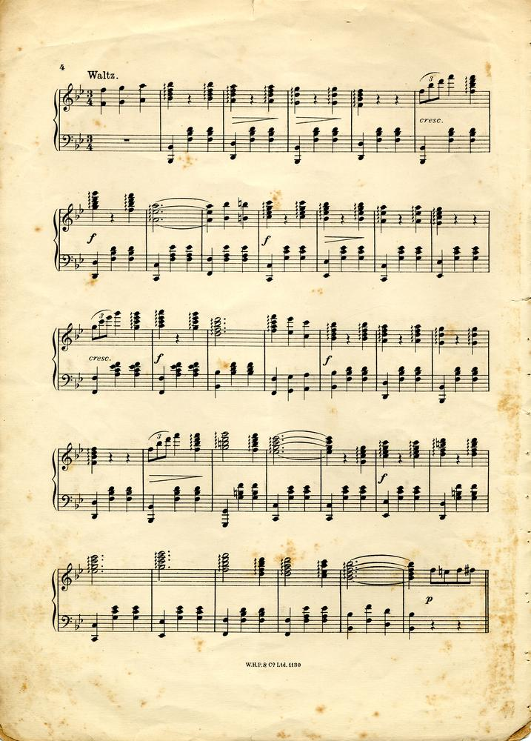
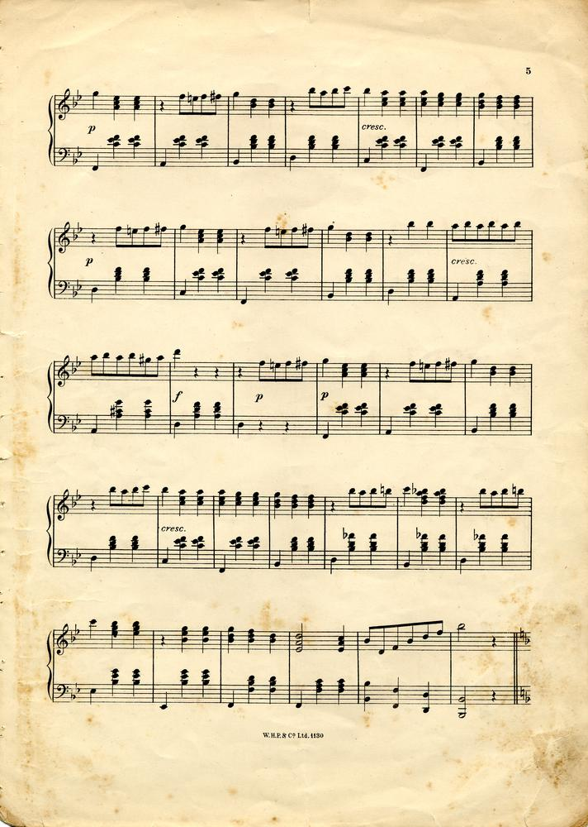
Queensland Waltz
Rowland, Leila Ruth, 1879-1958
1908, Waltzes
?

Slide 6
Colours
Buttons
Fonts
#5B3347
#FAF1DE
BUTTON
BUTTON
BUTTON
PT Serif – Bold, Italics
PT Serif – Bold
PT Serif – Regular
#32302C
#F4E1BA
Normal
Hover
Selected /
Unavailable

